Slide 1
What is Mindful Self Judgment? and Can It Be Useful?
June Price Tangney
Jeff Stuewig
George Mason University

Slide 2
NonJudgment
Nonjudgment (especially nonjudgment of the self):
A core dimension of many mindfulness approaches

Slide 3
NonJudgment
The mindful individual strives to experience the world and the self as they are…
…without judging and evaluating.

Slide 4
Big question:
But might there be some circumstances in which mindful self-judgment may be appropriate and functional?

Slide 5
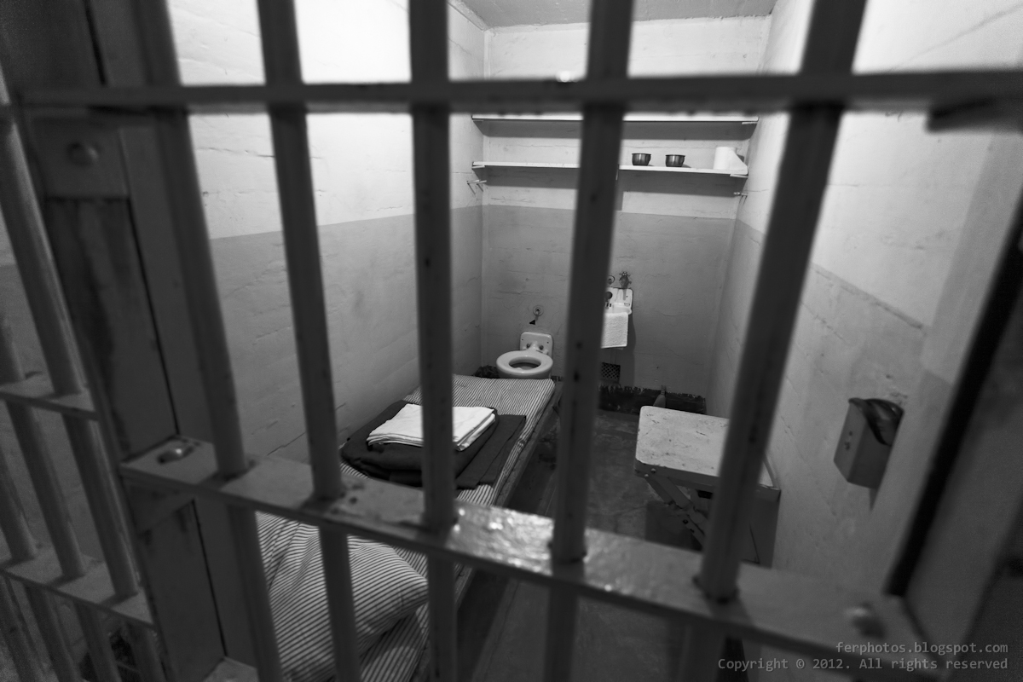

Slide 6
Core mind components
 | Cohen’s d | β
Present Awareness | .33 (p=.33) | -.07 (p=.69)
Metacognition | .00 (p=.99) | -.01 (p=.62)
Quiet Mind | .03 (p=.94) | -.02 (p=.94)
Willingness/Acceptance | .90 (p=.01) | -.01 (p=.96)
Nonjudgment-self | -.84 (p=.02) | -.49 (p=.02)
Nonjudgment- others | -.15 (p=.65) | -.28 (p=.02)

Slide 7
Associated Constructs
 | Cohen’s d | β
Empathy | .06 (p=.83) | -.13 (p=.47)
Perseverance | .19 (p=.60) | .42 (p=.09)
Premeditation | .25 (p=.15) | -.04 (p=.86)
Borderline | .27 (p=.41) | -.26 (p=.08)
Self-Control | .34 (p=.79) | .23 (p=.20)
Shame | .70 (p=.05) | -.01 (p=.97)
Guilt | -.03 (p=.92) | .16 (p=.44)

Slide 8
What is shame?

Slide 9
Moral Emotions: Good ways and bad ways to feel bad
Shame and guilt are distinct emotions
On balance, guilt is the more adaptive emotion
Shame is much more problematic

Slide 10
What’s the difference between shame and guilt?

Slide 11
Phenomenological Differences
Between Shame And Guilt
SHAME
GUILT
Focus on entire self
Focus on specific behavior
Feel badly about ourselves
Feel badly about something we’ve done
“How could I have done that?”
“How could I have done that?”
Extremely painful
Moderately painful
Considerable shift in self-perception
Little shift in self-perception
Sense of shrinking, being exposed
Sense of tension, remorse
Self is impaired, paralyzed
No impairment, paralysis of self
Motivation to hide
Motivation to take reparative action
Adapted from Lewis (1971) and Lindsay-Hartz (1984)
June Tangney -- George Mason University

Slide 12
Shame and Guilt are Not Equally “Moral” Emotions
Motivations
Externalization of Blame
Anger and Aggression
Deterring Immoral Behavior
June Tangney -- George Mason University

Slide 13
Shame and Guilt are Not Equally “Moral” Emotions
Hiding vs. Amending
Shame → attempts to deny, hide or escape the shame situation
Guilt → to reparative action – confessing, apologizing, undoing.
June Tangney -- George Mason University

Slide 14
Shame and Guilt are Not Equally “Moral Emotions”
Blaming vs. Accepting Responsibility
Shame is robustly linked to externalization of blame
Guilt is inversely related to externalization; guilt is associated with accepting responsibility
June Tangney -- George Mason University

Slide 15
Shame and Guilt are Not Equally “Moral” Emotions
Anger and Aggression
Shame-prone individuals are prone to anger and hostility
Once angered, manage anger in unconstructive fashion
Guilt-prone handle anger pro-actively and constructively
June Tangney -- George Mason University

Slide 16
Shame and Guilt are Not Equally “Moral” Emotions
Deterring Transgression and Antisocial Behavior
Common assumption: shame helps people avoid “doing wrong”, decreasing the likelihood of transgression
No evidence for an adaptive function of shame
In fact, undergrads’ self-reported moral behaviors were:
substantially positively correlated with guilt-proneness,
but unrelated to proneness to shame
June Tangney -- George Mason University

Slide 17
Shame and Guilt are Not Equally “Moral” Emotions
Guilt is the moral emotion of choice!
June Tangney -- George Mason University

Slide 18
Shame and Guilt are Not Equally “Moral” Emotions
Guilt is the moral emotion of choice!
Shame is its evil twin
June Tangney -- George Mason University

Slide 19
Shame and Guilt are Not Equally “Moral” Emotions
Guilt is the moral emotion of choice!
Shame is its evil twin?
June Tangney -- George Mason University

Slide 20
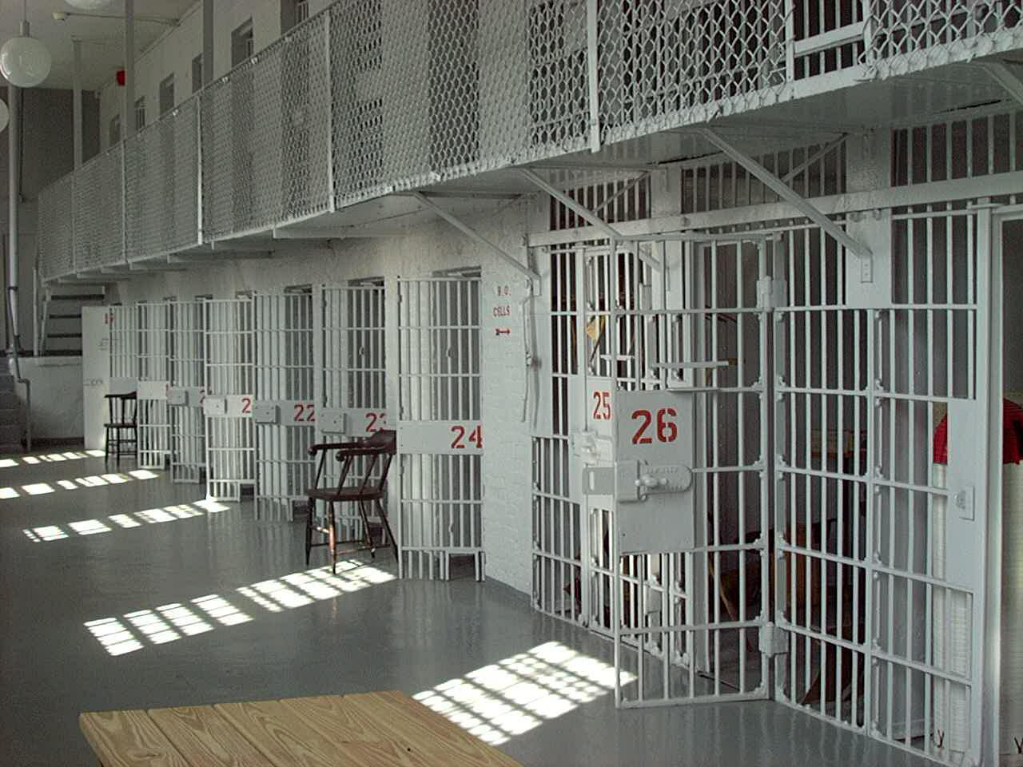

Slide 21
GMU Longitudinal Inmate Study 1
511 Inmates followed longitudinally
Recruited entering Adult Detention Center in suburban Washington DC
Pre- and Post-trial
Felony charges
69% Male, 31% Female
Mean Age = 32 yrs (SD = 10.1, Range = 18-72)
43% African American
35% Caucasian
11% Mexican American/Hispanic
3% Asian/Pacific Islander
8% Other/Mixed

Slide 22
GMU Inmate Study Timeline
Inmate arrives at ADC
Phase I
Phase II
Phase III
Phase IV
Phase V Phase VI
(Intake Assessment)
(Period of Incarceration)
(Pre-Release Assessment)
(Post-Release Assessment)
4 weeks
4 wks. to 30 yrs.
1 year 4 years 7 years
Informed Consent
Moral Emotions
- Shame
- Guilt
- Empathy
Moral Cognition
- Criminogenic Cognitions
Psychopathy
IQ
Strengths/Values
- Spirituality
- Optimism
Drug/Alcohol Use
HIV Risk Behavior
Health
Track use of services
Track jail behavior/adjustment
Experimental evaluation of Intensive Case Management Program and Impact of Crime Workshop
Moral Emotions
- Shame
- Guilt
- Empathy
Moral Cognition
- Criminogenic Cognitions
Strengths/Values
Health
Moral Emotions
Moral Cognition
Strengths/Values
Health
Recidivism
- Recorded Arrests
- Recorded Convictions
- Self Reported Re-Offenses
Rehabilitation
- Credit
- Residential
- Driving
- Child Support
Drug/Alcohol Dependence
HIV Risk Behavior
Moved to General Population

Slide 23
Key Question
Can moral emotions (shame and guilt) predict criminal recidivism?

Slide 24
Assessing Recidivism
The GMU Jail Inmate Studies
One Year Post-Release
(N = 481)
Official Records (FBI)
Arrests
Y/N
Number of arrests

Slide 25
Assessing Recidivism
The GMU Jail Inmate Studies
One Year Post-Release
(N = 328)
Self-reported arrest
Y/N
Versatility (types of crime)
Self-reported offenses not detected
Y/N
Versatility (types of crime)

Slide 26
Percentage Reporting Arrest and/or Undetected Crimes at 1 Year Post-release
Recidivism at 1 Year Post-Release

Slide 27
Key Question
Can moral emotions (shame and guilt) help predict criminal recidivism?
Hypothesized:
Guilt will negatively predict recidivism
Shame will positively predict recidivism

Slide 28
Shame and Guilt at Onset of Incarceration Predicting One-Year Post-Release Recidivism

Slide 29
Shame at Onset of Incarceration Predicting One-Year Post-Release Recidivism

Slide 30
Mediational Model:
Shame predicts Recidivism via Externalization of Blame

Slide 31
Partial Mediational Model:
Shame predicts Recidivism via Externalization of Blame

Slide 32
Hypothesis: “Inconsistent mediation”
(MacKinnon, Krull & Lockwood, 2000)
Special case of partial mediation
Mediated effect exerts influence in one direction
Direct effect exerts influence in opposite direction
The two effects often cancel one another out

Slide 33
Partial Mediational Model
(Inconsistent Mediation):
Shame Predicting Recidivism

Slide 34
Next Steps:
Does Mindfulness Moderate the Link Between
Shame and Externalization of Blame

Slide 35
Next Steps
Does Mindfulness Moderate the Link Between
Shame and Externalization of Blame?
Longitudinal Jail Study #2 (n=200)

Slide 36
Next Steps
Does Mindfulness Moderate the Link Between
Shame and Externalization of Blame?
Longitudinal Jail Study #2 (n=200)
Is Mindful Shame Useful in the Long Run?
REVAMP RCT – 3 mo Post-Release Follow-up

Slide 37
Conclusions
A complete absence of self judgment is undesirable

Slide 38
Conclusions
A complete absence of self judgment is undesirable
Guilt is the moral emotion of choice
Shame is generally its evil twin

Slide 39
Conclusions
A complete absence of self judgment is undesirable
Guilt is the moral emotion of choice
Shame is generally its evil twin
But there may be circumstances when shame is useful

Slide 40
Conclusions
A complete absence of self judgment is undesirable
Guilt is the moral emotion of choice
Shame is generally its evil twin
But there may be circumstances when shame is useful
Serious transgressions, with serious consequences, truly “self” relevant

Slide 41
Conclusions
A complete absence of self judgment is undesirable
Guilt is the moral emotion of choice
Shame is generally its evil twin
But there may be circumstances when shame is useful
Serious transgressions, with serious consequences, truly “self” relevant
When one is willing and able to tolerate the pain of shame, without denial/externalization of blame

Slide 42
Conclusions
Individuals living a life at odds with their core values may benefit from mindful self-judgment….
With the benefit of a willing attitude and enhanced abilities to self-regulate…

Slide 43
Conclusions
Individuals living a life at odds with their core values may benefit from mindful self-judgment….
With the benefit of a willing attitude and enhanced abilities to self-regulate…
They may benefit from taking a good hard look at the self and their behavior…
Tolerating the negative affect,
Avoiding the temptation to become defensive, and
Utilizing that discomfort to motivate positive change going forward.

Slide 44
Conclusions
ACT-inspired interventions may help them do so

Slide 45
Many Thanks
NIDA, Center for Consciousness and Transformation
Mark Hastings, Ph.D.
Leah Adams, M.A.
Kelly Moore, M.A.
Fairfax ADC Staff
Inmate Participants
*BJS

Slide 46
MANY THANKS...
To the many graduate and undergraduate students who have worked in the Human Emotions Research Lab:
Tania Abi-Najm, Leah Adams, Nicole Adock, Gayathri Adikesavan, Kauser Ahmed, Cecilia Anon, Molly Appel, Jalmeen Arora, Chris Arra, Zara Arshad, Brian Athey, Judy Back, Deb Hill-Barlow, Sheri Bailey, Ruth Barrientos, Rebecca Beam, Kim Becker, Mary Bolton, Angie Boone, Eleni Boosalis, Elly Bordeaux, Julie Borenstein, Laura Bowling, Thea Bowling, Lorenzo Bozzelli, Adam Brode, Phyllis Brodie, Tracey Brown, Lorenzo and Mina Bozzelli, Crystal Brothers, Heather Buller, Dalo Burje, Rachel Burroughs, Hannah Bustamante, Daniela Butler, Phyllis Byrne, Rhonda Campagna, Lisa Cannaday, Solange Caovan, Kyle Carlson, Eliana Castano, Meredith Cato, Tina Chan, Ericka Cho, David Choi, Lauren Christensen, Margaret Claustro, Luis Clavijo, Sarah Clements, Emily Clime, Erin Clyne, Eddie Codel, Bill Connell, Lisa Conner, Joe Constantin, Kenny Corson, Susan Cottrell, Michelle Covert, Brit Creelman, Helena Crick, John Crum, Sheila Cunningham, Ingrid Czintos, Chrissy Dale, Devra Dang, Zermarie Deacon, Ronda Dearing, Deanna DeGidio, Steve Devers, Bronwyn Devlin, Rosangela Di Manto, Ashley Dobbins, Robin Dold, Karisa Dominguez, Bertille Donohoe, Andy Drake, Amy Drapalski, Rebecca Duckworth, Robert Dumville, Kristen Durbin, Leigh Earley, Keesha Edwards, Kate Egbert, Rebekka Eilers, Drew Emery, Pam Estilong, Daniela Ettlinger, Barbara Evans, Samantha Fede, Kate Federline, Diana Fitek, Michelle Flanagan, Naheed Flanagan, Carey Fletcher, Laura Flicker, Jen Floor, Bridget Fonseca, Kerry Ford, Peter Forkner, Megan Formeck, Faye Fortunato, Marcelle Fozard, Karen Friedman, Juan Funes, Dee Dee Atkinson-Furr, Emi Furukawa, John Gavlas, Casey Gilchrist, Lynn Glikbarg, Lauren Gonzales, Melissa Gonzalez, Monica Gonzalo, Gerica Goodman, Kimberely Goodman, Jennifer Gosselin, Richard Gramzow, Theresa Grant, Beth Gunzelman, Logaina Hafez, Angela Hall, Sarah Hall, Alice Hansburger, Barbara Harding, Bill Harman, Sharie Harman, Angie Harris, Laura Harty, Mark Hastings, Kim Havenner, Marna Hayes, Ashley Heald, Courtney Heffernan, Caron Heigel, Nancy Heleno, Charlie Hendricks, Jolene Hering, Sheena-Dave’ Heslop, Dustin Higgins, Rachel Hite, Junellyn Hood, Kelly Hughes, Leslie Hughes, Mark Hyer, Miguel Iglesias, Nikki James, Rebecca Jackson, Tricia Jacobsen, Christina James, Margaret Jefferies, Ashley Jennings, Charlotte Joelsson, Heather Johnson, Karen Johnson, Mark Johnson, Caydie Jones, Heather Jones, Sarah Jones, Sara Julian, Sahair Kaboli-Monfared, Kristina Kallini, Ramineh Kangarloo, Marc Kaplan, Lesley Kato, Stephanie Kendall, Amy Kiernan, Nicole Kierein, Agnes Kim, Elysha Kim, Leslie Kirk, Sarah Klein, Linda Knauss, Greg Kramer, Stephanie Kowal, Chris Krause, Shilpa Krishnan, Maria Lacayo, Allan Langley, Patrick Lechleitner, Sylvia Lederman, Norman Lee, Elizabeth Leon, Jennifer Lerch, Pete Lielbriedis, Julie List, Claudia Lopez, Conrad Loprete, Charmaine Lowe, Michaela Lynch, Devon Madison, Jessica Magrath, Harry Malik, Elizabeth Malouf, Terri Markel, Andrea Martinez, Debra Mashek, Donna Marschall, Luis Mateus, Narges Maududi, James Maxfield, Lauren McGill, Heather McGraw, Megan McKenny, Mary McKnight, Amy McLaughlin, Patrick Meyer, Natalie Migliorini, Kimberly Minnema, Katie Mitchell, Sean Mitchell, Tim Mohr, Joanne Moller, Kelly Moore, Julie Morig, Corkie Morrill, Noha Mostafa, Kristen Mudrezow, Amy Muntz, Sara Mutnick, Melody Myers, Yvette Nageotte, Yasi Nejat, Nhu Nguyen, Thuy Nguyen, Vienna Nightingale, Jean No, Kyle Novak, Amanda Nuber, Beverly Nyokabi, Windi Oehms, Lia Ojeda, Judy Okawa, Dulce Orozco Martinez, Gabriel Ortiz, Jose Osorio, Erica Otter, Troy Pafenberg, Helen Pak, Gita Parlier, Caite Partamian, Elizabeth Patchen, Akhil Pathania, Jeff Pattison, Ray Payton, Chad Peddie, Phillip Pegg, Julie Pelch, Will Pennell, Geoffrey Pennoyer, Enrique Peralta, Marc Perez, Jill Perkins, Erica Perry, Amy Peterson, Dave Petersen, Greg Petrecca, Heather Phillips, Giorgia Picci, Kayla Pope, Steve Potter, Michelle Price, Erin Quigley, Adam Rabinowitz, Sara Rahai, Paula Raikkonen, Samira Ramezan, Michael Raumer, Candi Reinsmith, Megan Remener, Justin Reznick, Claudia Reyes, Katie Rich, Nakiia Robeson, Diana Rodriguez, Fernando Rodriquez, Monique Romeo, Charles Rong, Lori Roop, Karen Rosenberg, Tricia Roy, Melissa Rudy, Karey Rush, Candice Russell, Gary Russell, Provie Rydstrom, Paul Saenz, Leila Safavian, Dolly Saini, Jackie Sakati, Veronica Sanchez, Jennifer Sanftner, Lauren Saunders, Karen Schaefer, Ann Scharff, Heather Sevier, Danielle Sewell, Vicki Shaffer, Ann Shannon, Gordon Shaw, Kay Shows, Farhad Siahpoush, Jenn Sims, Deb Sinek, Chris Smart, Alison Smith, Deena Smith, Erika Smith, Steve Smith, Caryn Smonskey, Alisa Sneiderman, Jonathan Sollinger, Larry Spahr, Sabrina Speights, Brad Starring, Gary Stone, Stephanie Storck, Jeff Stuewig, Bianchi Suarez, Jenn Sullivan, Lauren Tangney, Tina Tehrani, Angela Termini, Dave Testa, Gia Thi, Rebecca Thompson, Chris Tiller, Andrea Thorson, Tammy Tower, Mike Tragakis, Berrin Tutuncuoplu, Tony Tzoumas, Kim Udell, Lisa Unrine, Jocelyn Valenzuela, Jacqueline Valdes, Suchi Vatsa, Jennifer Vaught, Marilyn Vivanco, Ivan Voronin, Svenja Wacker, Patti Wagner, Tammy Walker, Katherine Wallace, Rebecca Warden, Abigail Wear, Julie Weismoore, Kristine Welch, Dane Westermeyer, Simone Whyte, Dina Wieczynski, Rebecca Wilbur, Layla Wilder, Kelsey Wilkerson, Lauren Williams, Tara Williams, Brittany Wilson, Edward Witt, Sabura Woods, Susan Wyman, Autumn Yang, Tim Yerington, Siyon Yi, Kerstin Youman, Doris Yuspeh, Parin Zaveri, Nancy Zenich, Kate Zinsser, Patty Zorbas, and Tev Zukor

